Slide 1
What is design pattern ?
“In software engineering, a design pattern is a general repeatable solution to a commonly occurring problem in software design.”
Pattern is not a piece of code or a library available for importing to our project. It’s just a solution in your mind to resolve design problems.

Slide 2
Why should we use design patterns ?
Because it help us resolve “commonly occurring problem in software design”

Slide 3
Which type of available design pattern ?
Have 23 types of pattern by Gang of four GOF.
Creational: Abstract Factory, Builder, Factory, Prototype, Object Pool, Singleton,
Structural: Adapter, Bridge, Composite, Decorator, Facade, Flyweight, Proxy patterns,
Behavioral: Chain of Responsibility, Command, Iterator, Mediator, Memento, Observer, State, Strategy, Template, Visitor, and Interpreter

Slide 4
Creational design patterns
Creational patterns are ones that create objects, rather than having to instantiate objects directly. This gives the program more flexibility in deciding which objects need to be created for a given case.
Abstract factory groups object factories that have a common theme.
Factory method creates objects without specifying the exact class to create.
Singleton restricts object creation for a class to only one instance.

Slide 5
Structural design pattern ?
These concern class and object composition. They use inheritance to compose interfaces and define ways to compose objects to obtain new functionality.
Adapter allows classes with incompatible interfaces to work together by wrapping its own interface around that of an already existing class.
Proxy provides a placeholder for another object to control access, reduce cost, and reduce complexity.

Slide 6
Behavioral design pattern ?
Observer is a publish/subscribe pattern which allows a number of observer objects to see an event.

Slide 7
Basic knowledge review
Abstract class, pure abstract class
Virtual method
Pure virtual → interface in java/higher level programming language /can not create instance of interface
Multiple Inheritance
Overload/override and static/dynamic polymorphism
Inline function vs macro

Slide 8
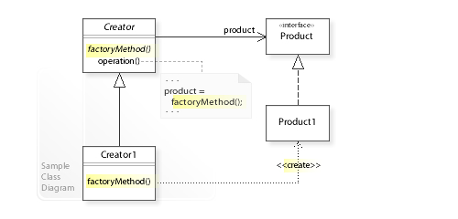
Factory Method

Slide 9
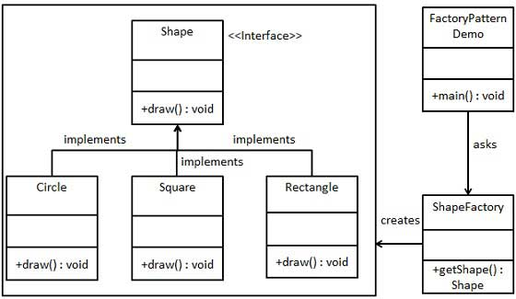
Factory Method

Slide 10
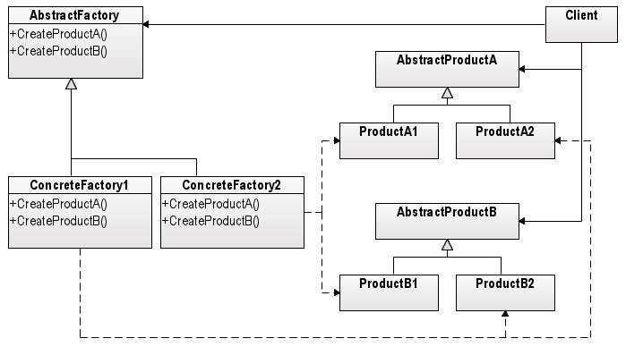
Abstract Factory

Slide 11
Singleton

Slide 12
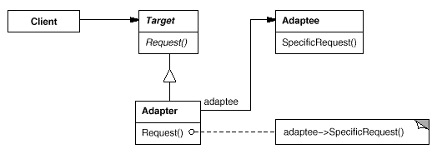
Adapter

Slide 13
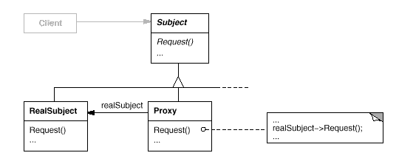
Proxy

Slide 14
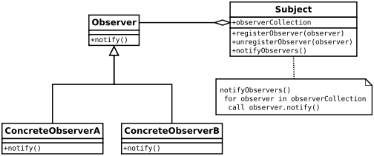
Observer

Slide 15
Abstract Factory

Slide 16
Abstract Factory

Slide 17
Apply to LCM linux
When should we use factory method / abstract factory
Why factory was applied into lcm.

Slide 18
Factory in LCM

